Slide 1
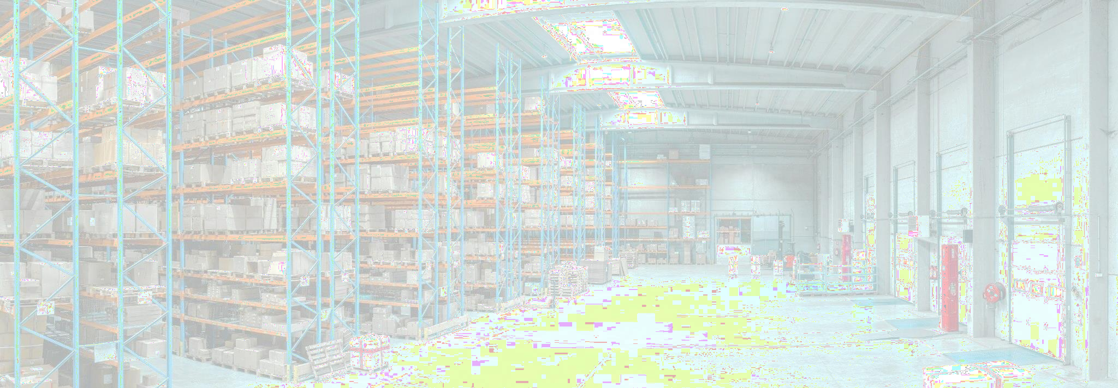
Supply Chain Analytics - Late Delivery Risk Prediction
Shivendu Kishore & Ayush Singh

Slide 2
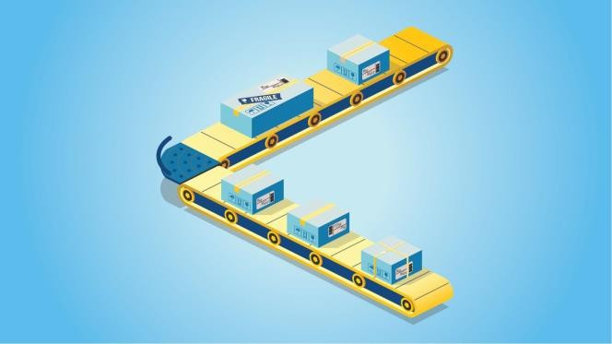
Business Overview
Exposed to the wave of the Covid-19 pandemic, the marketplace industry experienced an exponential surge in sales it is one of the triggers that ultimately encourages people to shop online, which ultimately brings benefits to certain lines of business, one of which is a third-party logistics service provider (Third Party Logistics). Competition among logistics service providers is heating up, new start-ups are emerging to answer the needs of order fulfillment services. After the pandemic subsided, the competition between logistics companies finally tried to offer various new benefits to support changes in business models for customers. B2B services to deal with customers who increasingly want to shop in offline stores, cooperation with several delivery service providers, and of course, increase order fulfillment speed. Through this analysis, the authors hope to exchange ideas regarding what are the factors that influence the delay in order fulfillment using machine learning models.

Slide 3


Problems
Steps
Late Delivery Risk factor.
What affects the level of
fulfillment speed, as well as the
characteristics of orders that can trigger the emergence of late delivery risk.
Recommendation
What are the recommendations and
improvised strategies that can increase the speed of order fulfillment and the preventive measures that can be taken to deal with delays.
Data Preparation &
Profiling
Exploratory Data Analysis
Preprocessing
Modeling Preparation
Modelling
Recommendation
order

Slide 4

DataCo Smart Supply Chain for Big Data Analytics
Numpy, Pandas, Matplotlib, Seaborn, Sklearn
2 Columns have
155.679 &
180.519 rows of null data, and mostly columns have high cardinality.
Data
Profile
Selection
Data has :
- 180.519 rows
53 columns
- 14 Int64
15 Float64
24 Object
For Late Delivery Risk analysis, we will use columns Late_delivery_risk
, Category Name, Market, Order
City, Order
Country, Order
Item Quantity,
Python
Library
Null Data & Cardinality
Order Region, Shipping Mode.

Slide 5
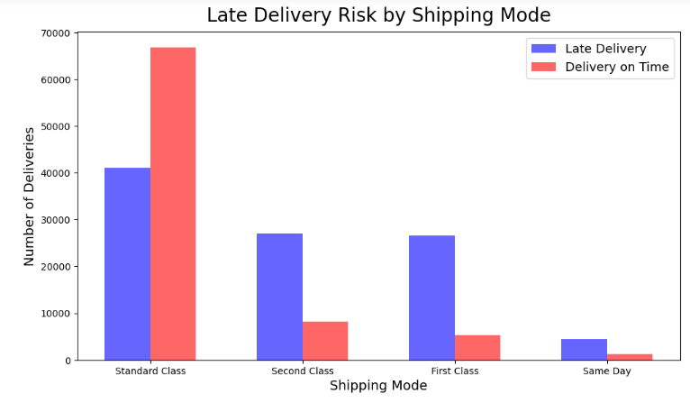
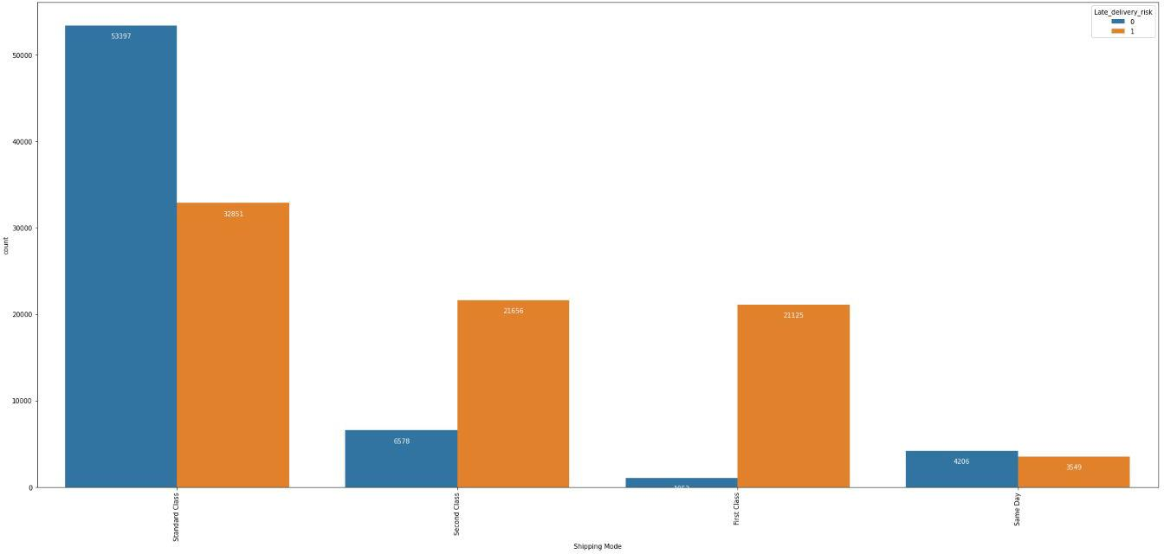
Shipping Modes do matter!
From the plot, we know that Shipping Modes can really determine in which late delivery risk more often to occur. As we can see the shipping mode that lowest chance to be over late delivery is Standard Class, however we could see that all other types of modes have very huge chance for late delivery service.

Slide 6
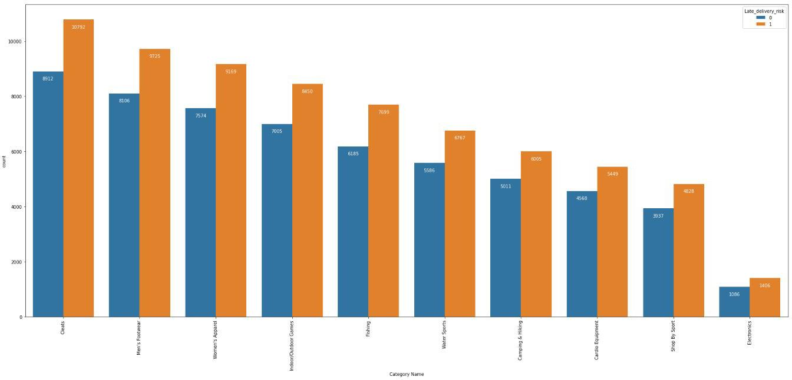
Category needs more deep analysis.
The Category didn’t seems very clear about determining late delivery risk. However, we know that some of category have different category movement. As we can see the more order for specific category is also more late delivery risk will show up.

Slide 7
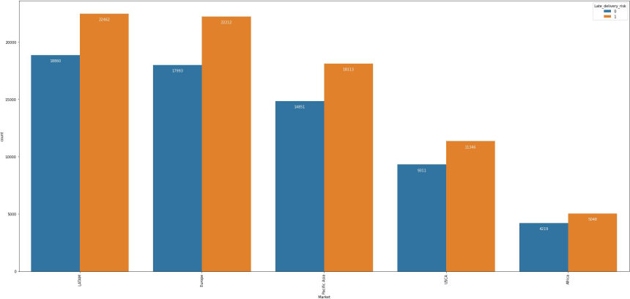
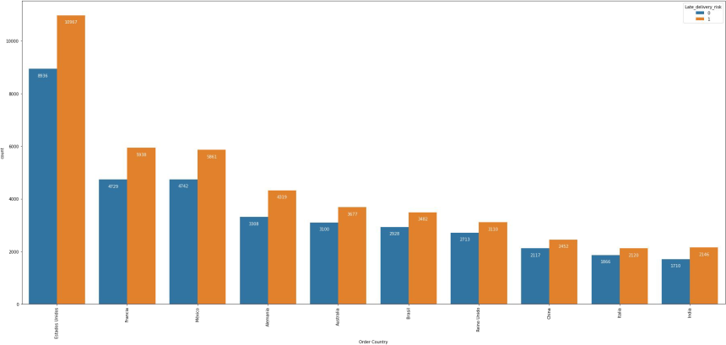
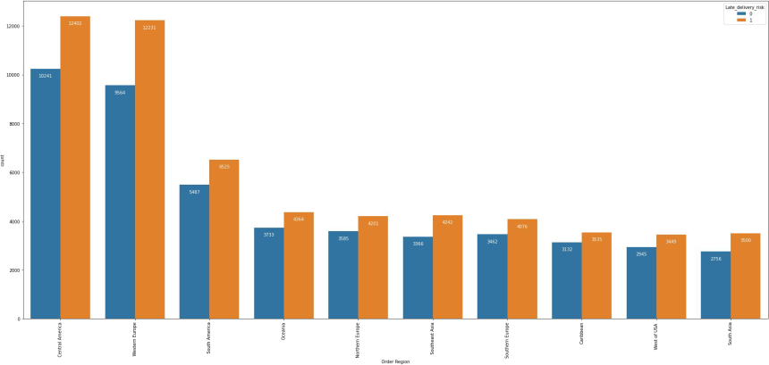
The distance is not really a problem.
As we can see, there is no clear evidence that the late delivery is because of the distance between fulfillment center and the customers. However, we need further analysis is there any factors except distance that really make raise late delivery risk.

Slide 8
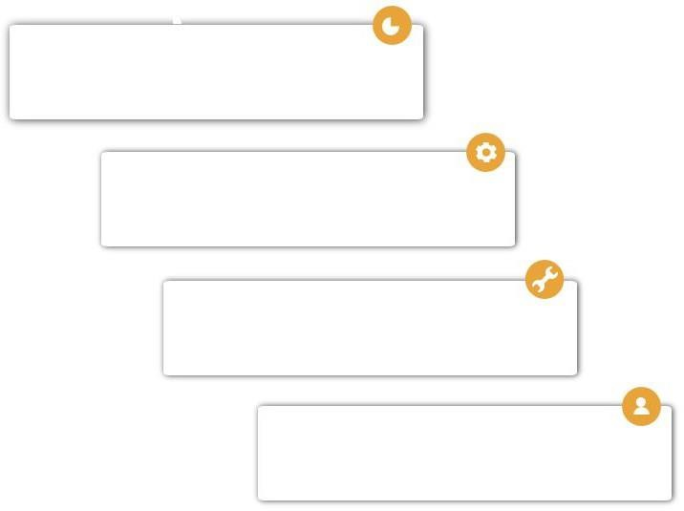
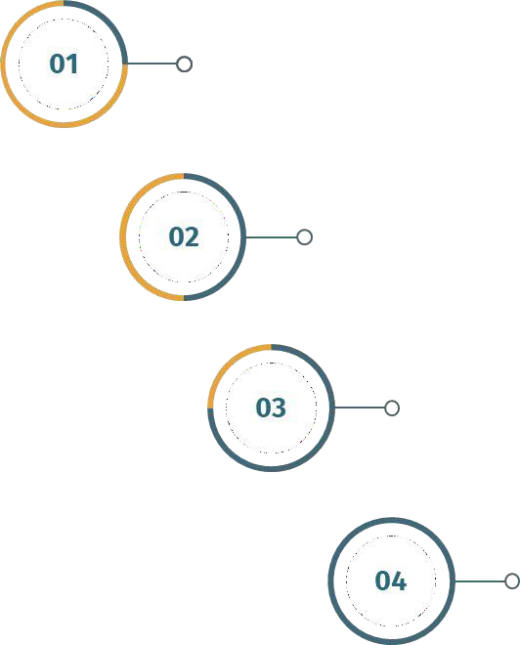
Anomalies Handling, we eliminate the null values for 21 rows & duplicated values
Feature Selection, we drop all ID column since it’s only contain unique ID for every rows.
Encoding, we replace the high cardinality category columns with label encoding and one hot encoding with dummy encoding.
Lets PreProcess our dataset!
As we can observe from dataset so far, there is column like Order Quantity. For these, we using standard scalar in order to generalize all value into 0 ~1.

Slide 9
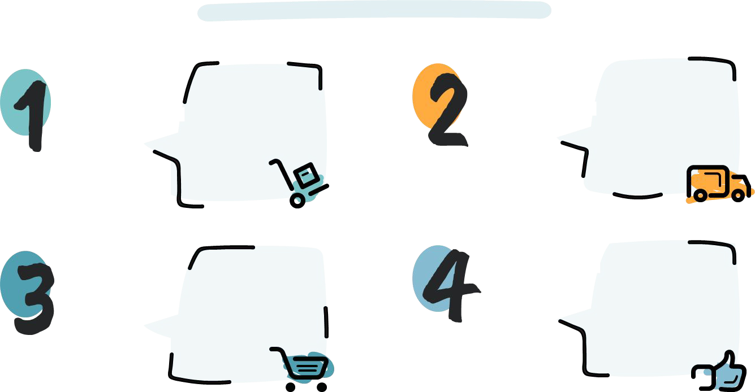
Choosing best model.
Accuracy
87.21%
Accuracy
79.30%
KNN
Naïve Bayes
Logistic Regression
Accuracy97.52%
Random Forest
Accuracy 96.41%
As we can see, the best model that best suit for our data set is Logistic Regression in terms of Accuracy.

Slide 10
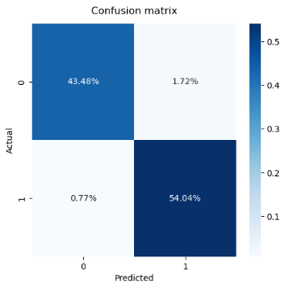
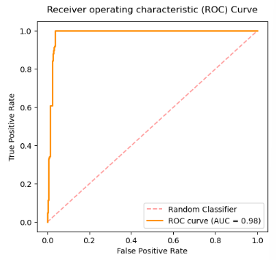
Let’s see how our model perform.
The confusion matrix show :
The model predicted delivery will be late and actually late is 54.04%.
(True Positive)
The model predicted delivery will not late and actually late is 0.77%.
(False Negative)
The model predicted delivery will late and actually not is 1.72%.
(False Positive)
The model predicted delivery will not late and actually not late is 43.48%. (True Negative)
ROC Curvers show that our model success rate in distinct True Positive and True Negative is 97%. With the F1-Score (the harmony between precision and recall) is 98%.

Slide 11
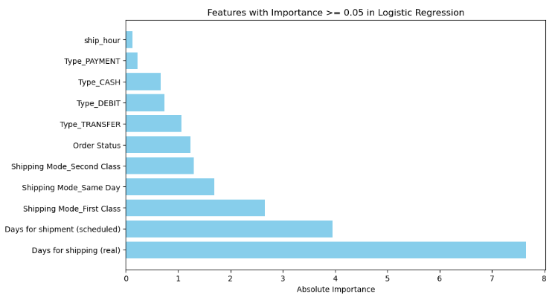
Now let’s talk with our machine learning model.
From the feature importance plot, we know that even there are many factor that impact late delivery, the higher effect comes from shipping mode. We know that if the more shipping mode get used by the company, the higher chance that the delivery will be on time.
From the feature importance, we know that the highest four importance variable that help our model to determine late delivery risk is :
Shipping Mode
Order Status
Payment Type
All of the following result really make sense.

Slide 12
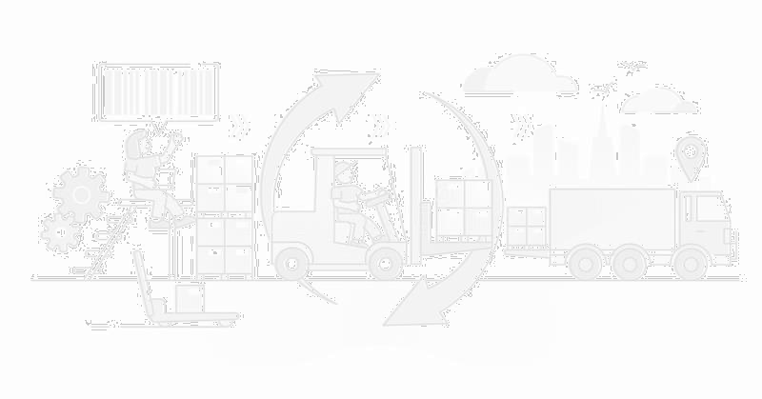
Last but not least, improvement step!
From the EDA and maching learning modelling, can formulate recommendation like :
Check the possibility of closing few of Shipping mode. We found that the Standard Class have best performance amongst all, so we can recommend this shipping mode for customer. We can also opening partnership with third-party courier with more sorting hub since we know where the potential orders comes from.
Doing more analysis for characteristic of the customer city. From the modelling we know that city more important than country and region in terms of predicting late delivery risk. Therefore, there is possibility that the distance is not so important. How about the road condition? Weather climate? or anything else that can determine late delivery risk on potential city.
Initiate movement grouping for all Category. From the modelling we know that Category is also have higher importance in determine late delivery risk. Therefore, we can make movement grouping to FAST, MED, and SLOW movement for the Category that company handle. So we can prepare the more effective layout for outbound staging to minimize the lead time for order processing.
Calculate manpower more efficiently. As we can see, the order quantity is also one of important feature. The company can calculate several point and analyze the possibility where the most needed for additional manpower. Also we can add the facility to maximize the productivity like conveyor belt so the picker could deliver the goods to packing station without actually walking there.

Slide 13
Will move to coding!
Thank you

